Slide 1

Reacciones locas al gol de Oyarzabal 2-1 contra Inglaterra (youtube.com)

Slide 2
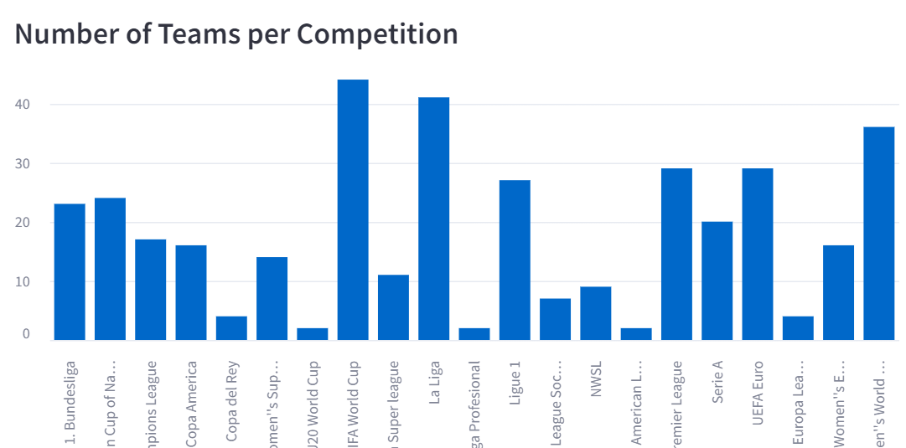

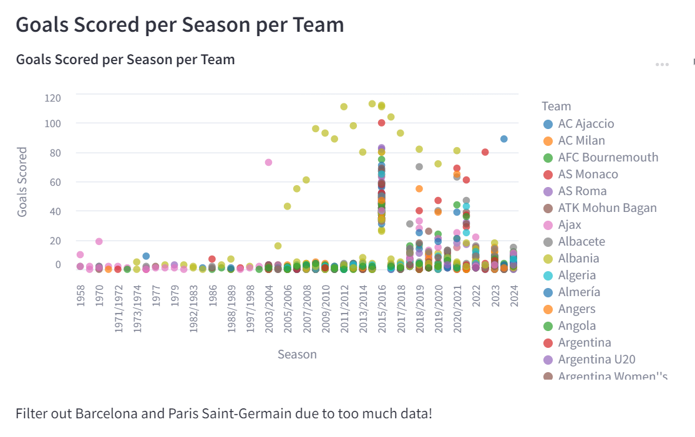
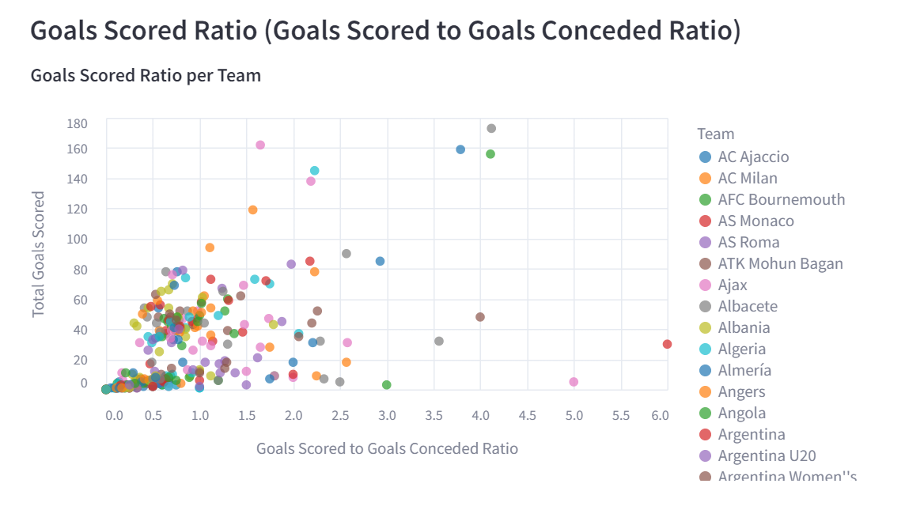
Football Data Analytics

Slide 3
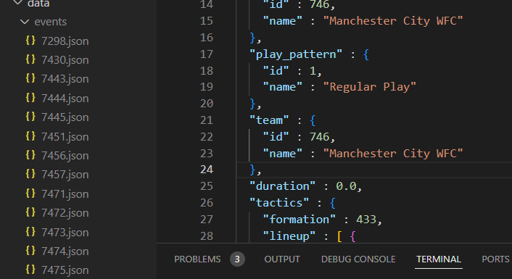
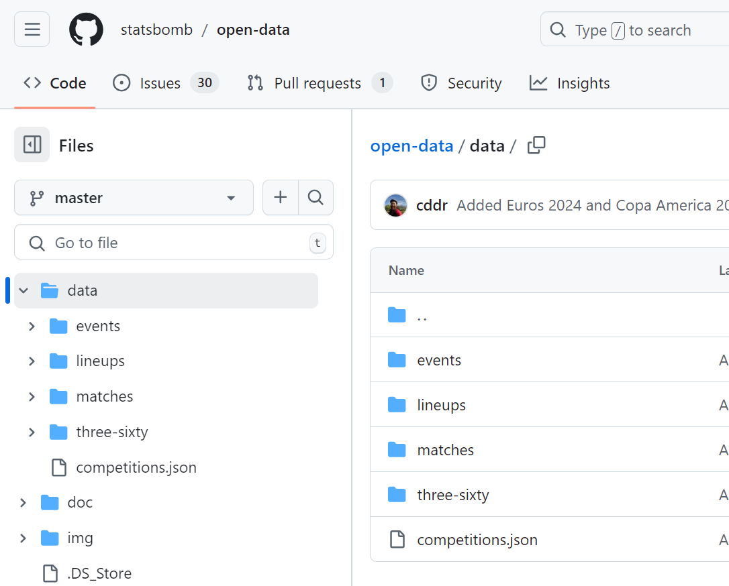
Football Data Analytics

Slide 4
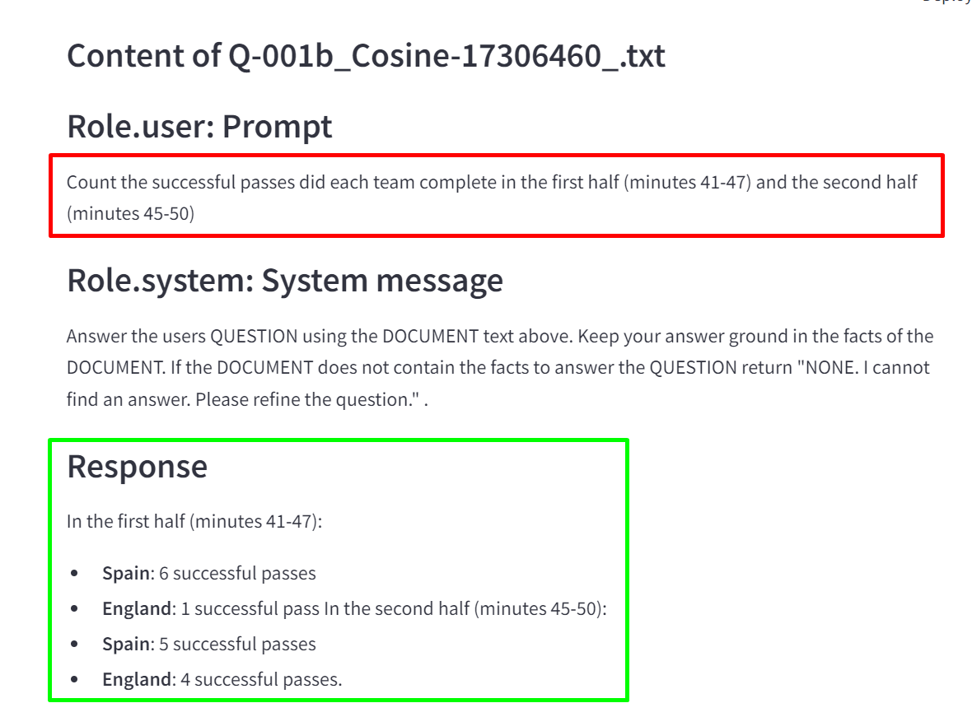
Football Data Analytics Copilot
What if you could query unstructured data to find answers?
In the first half of the match, at the 44th minute, the action began with **Jude Bellingham** of England making a pass from the left wing to **Harry Kane**, who was positioned as the center forward. This pass set up a potential scoring opportunity as Kane received the ball at the 44:04 mark.
Just a moment later, at 44:05, **Harry Kane** took a shot on goal. He executed a half-volley with his right foot, aiming to score from open play. However, the shot was blocked by **Rodrigo Hernández Cascante** of Spain, who was quick to react and made a crucial defensive play to prevent the goal.

Slide 5
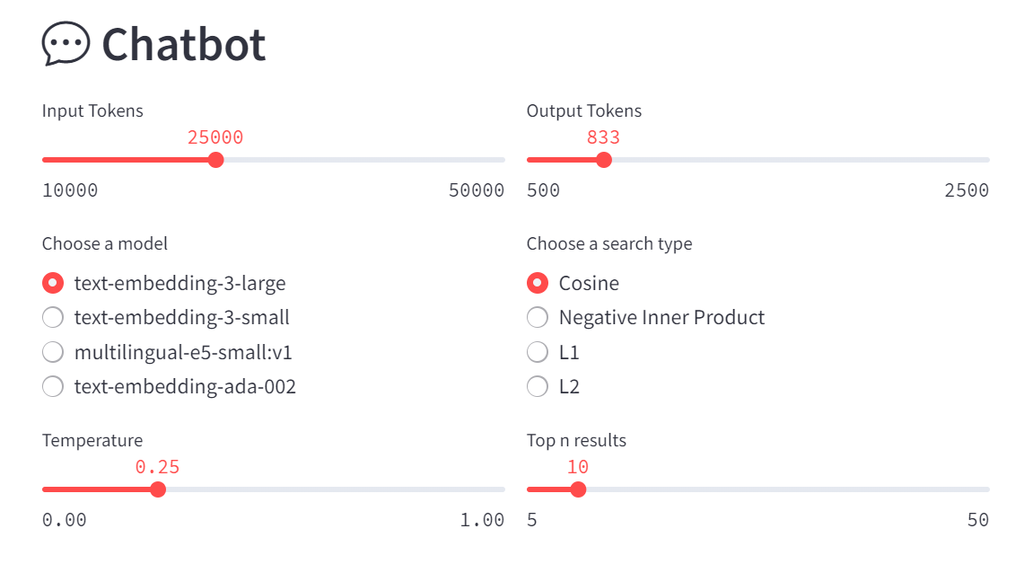
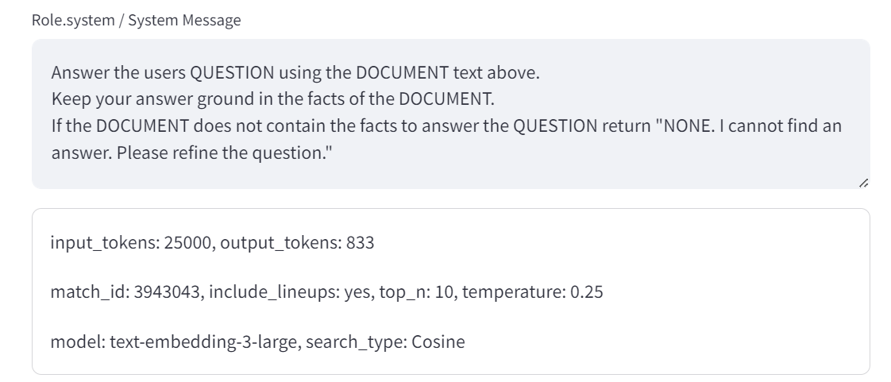
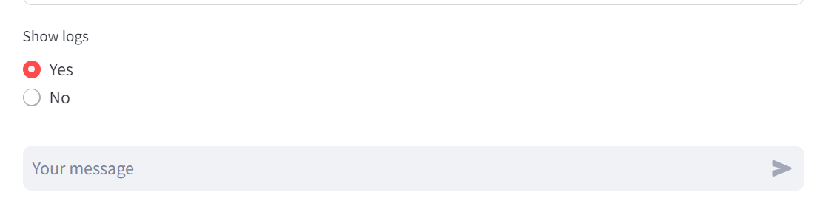
Football Data Analytics Copilot

Slide 6




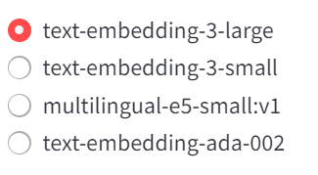
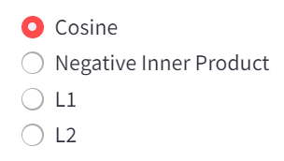
Advanced RAG Adding business data
Corner Kick: At 34:00, Lamine Yamal took a corner kick, but it was cleared by England's Marc Guehi at 34:07.
Tackle by Carvajal: At 60:00, Daniel Carvajal engaged in a crucial tackle against Luke Shaw but lost the duel.
Substitution: At 60:41, Harry Kane was replaced by Ollie Watkins, indicating a tactical shift for England.
List the critical moments or sequences, such as blocked shots, successful tackles, and goal attempts?
Postgres Extensions
- azure_local_ai
- azure_ai
- vector
embeddings
Script Data
In the 34th minute of the match, Spain's Lamine Yamal Nasraoui Ebana took a corner kick from the right wing. The inswinging corner was executed with his left foot..
User
Question
Large Language Model
Large Language Model
Data Domain
Result, Lineups
Competition, Season

Slide 7





Data Loading Architecture
JSON
Football Open Data
1
3
JSON
2
TEXT
JSON
Azure OpenAI
Client App
SQL DB
TEXT
VECTOR
4

Slide 8
DATABASE
MASTER KEY
PASSWORD
create master key encryption by password = N'V3RYStr0NGP@s0rd!';
DATABASE
SCOPED CREDENTIAL
TSQL
STORED
PROCEDURES
CREATE PROCEDURE [dbo].[get_embeddings] (
@model VARCHAR(MAX),
@text NVARCHAR(MAX),
@embedding VECTOR(1536) OUTPUT
)
API-KEY
create database scoped credential [https://<endpoint>.openai.azure.com]
with identity = 'HTTPEndpointHeaders', secret = '{"api-key": "<api-key>"}';
CREATE PROCEDURE [dbo].[get_chat_completion] (
@model VARCHAR(MAX),
@system_message NVARCHAR(MAX),
@user_prompt NVARCHAR(MAX),
@temperature FLOAT,
@max_tokens INT,
@max_attempts INT = 3,
@chat_completion NVARCHAR(MAX) OUTPUT
)

Slide 9
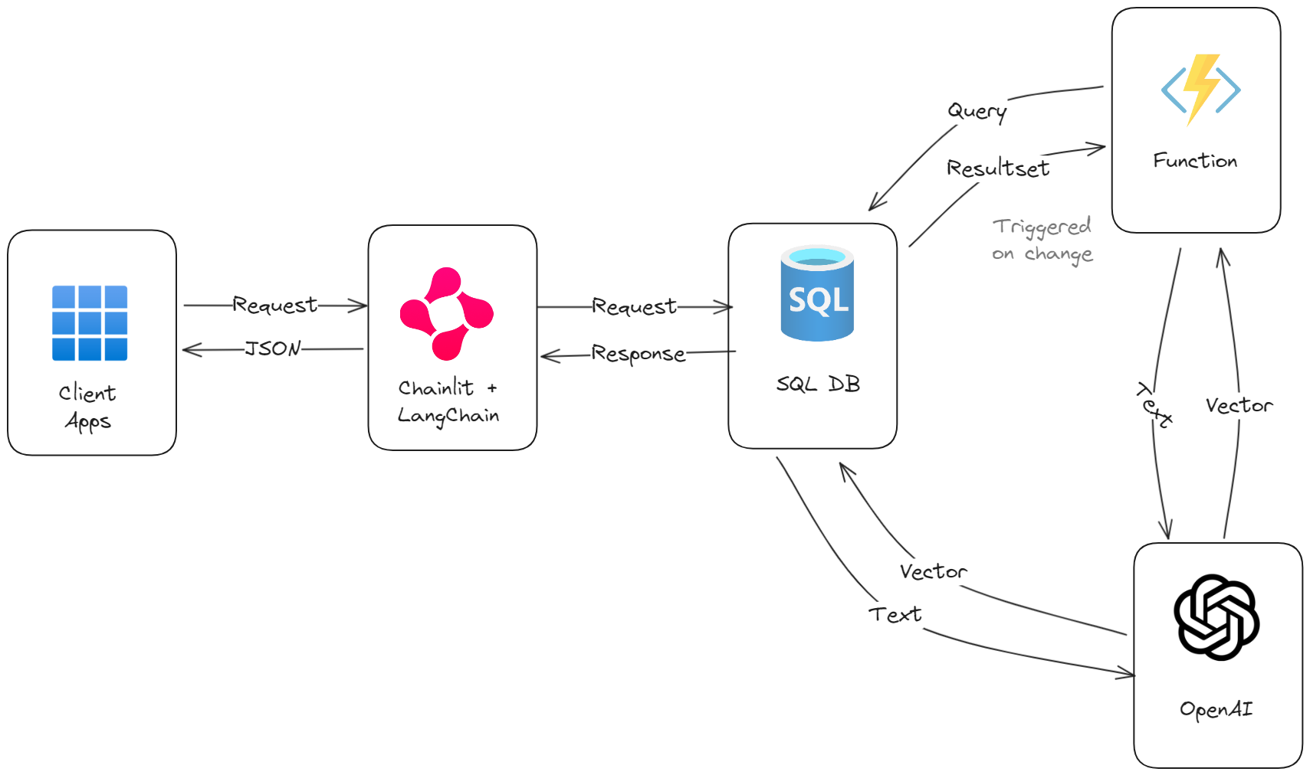

Football Open Data
SEARCH
TEXT
JSON
Azure OpenAI
Client App
SQL DB
TEXT
VECTOR

